Slide 2
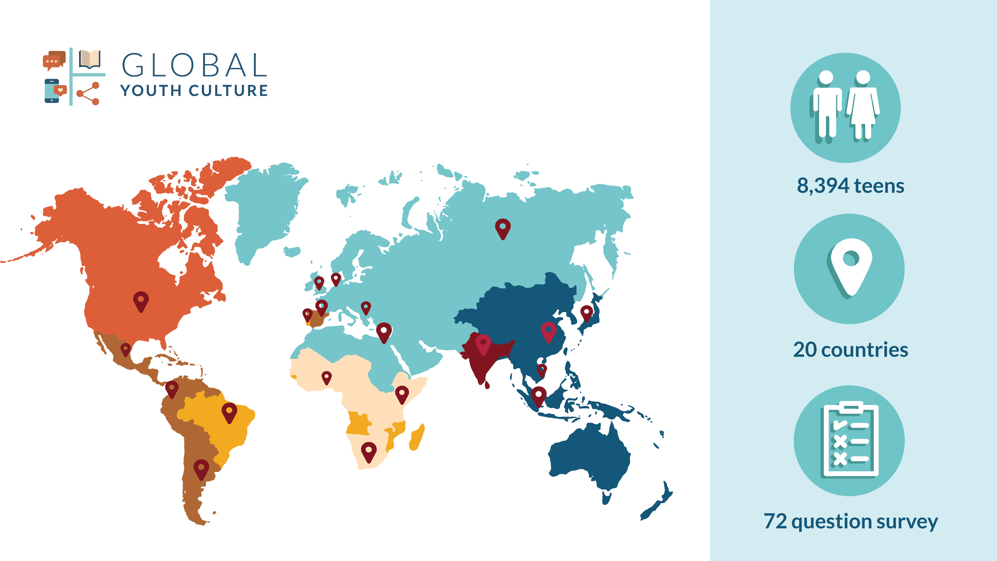
Notes:
This was a 2 year research process that began with focus groups to validate a survey instrument its translations and then The survey went out in 14 languages with a representative sample from 20 countries. Australia was actually country 21. we collected data here in June – July 2020 so you put us closer to 9000 teens altogether.

Slide 3
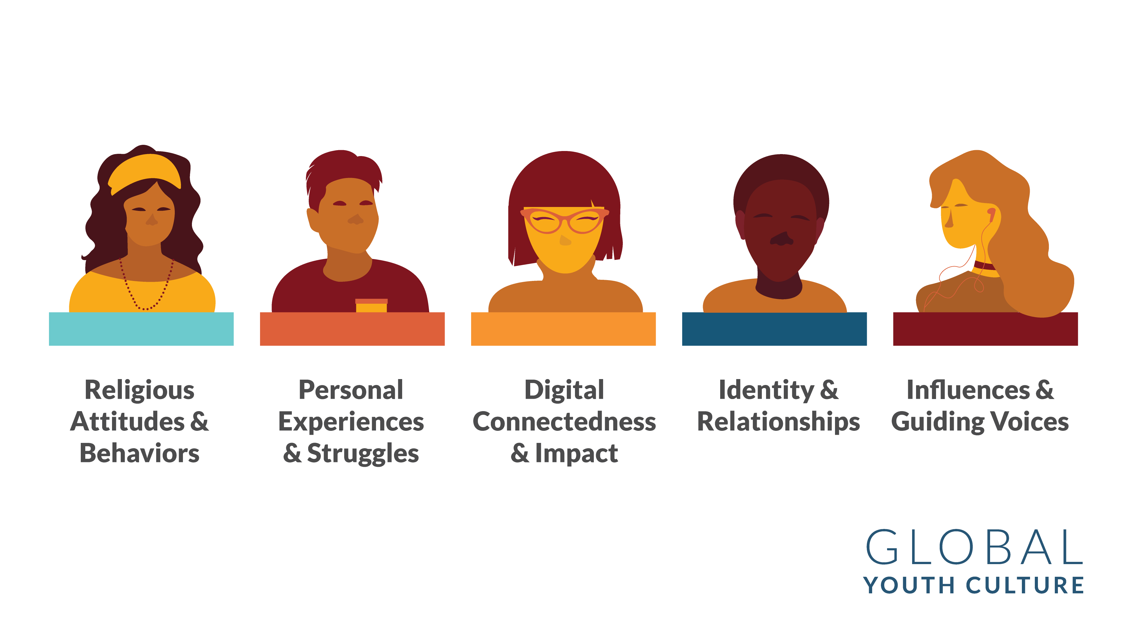
Notes:
The survey had over 70 questions that fell in 5 major domains.

Slide 4
Notes:
Australia is one of the most secular nations that we surveyed with 55% of young people saying that did not adhere to any religion. (Ranked 4th globally, with UK 5th at 55%; China, Japan, and Netherlands were higher)
Teens surveyed were 13-19 years old, with even representation of boys and girls. Most teens reported living in a two-parent household.

Slide 5
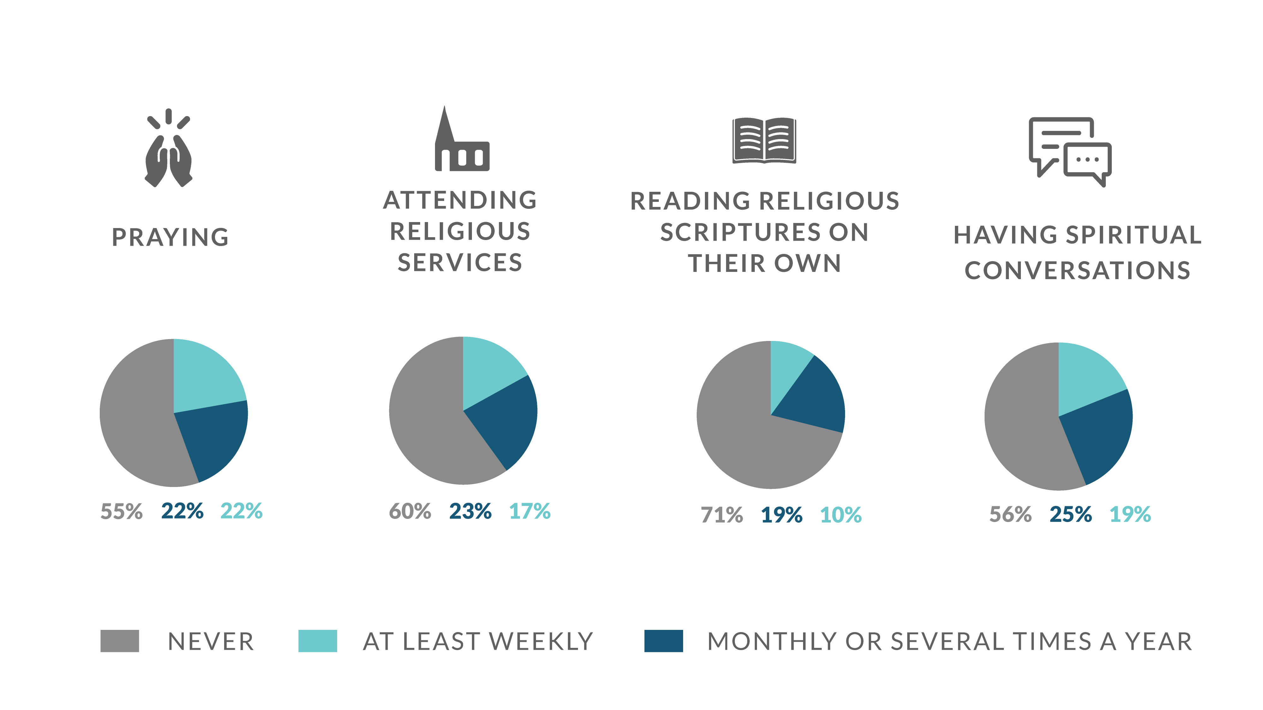
Notes:
We asked teens across Australia about 4 religious activities prayer, attending religious services, reading sacred scripture and having spiritual conversations.
You can see that in every case a majority answered they never do these things. So for example when we look at prayer about 1 in 5 teens told us they do this at least weekly compared to reading scripture on their own which was 1 in 10. Interestingly about 1 in 5 also have spiritual conversations

Slide 6
Notes:
These stats were a bit more troubling to us. It is one thing to be a non-religious teen and never do these things but among young people that identified as Christians -- about 1 in 4 said they never pray. Even more said they never attend church. Around said they never read the Bible on their own.
In fact, only 1 in 5 teens who identified as Christian said they look at the Bible at least once a week on their own. This is troubling. And this was an issue globally.
So we decided to go beyond self identification and look for what we would refer to as the committed Christian teen. There were some other issues with self identified Christians in that they looked a lot like the nones in mental health struggles and in issues of sexuality and gender identity.

Slide 7
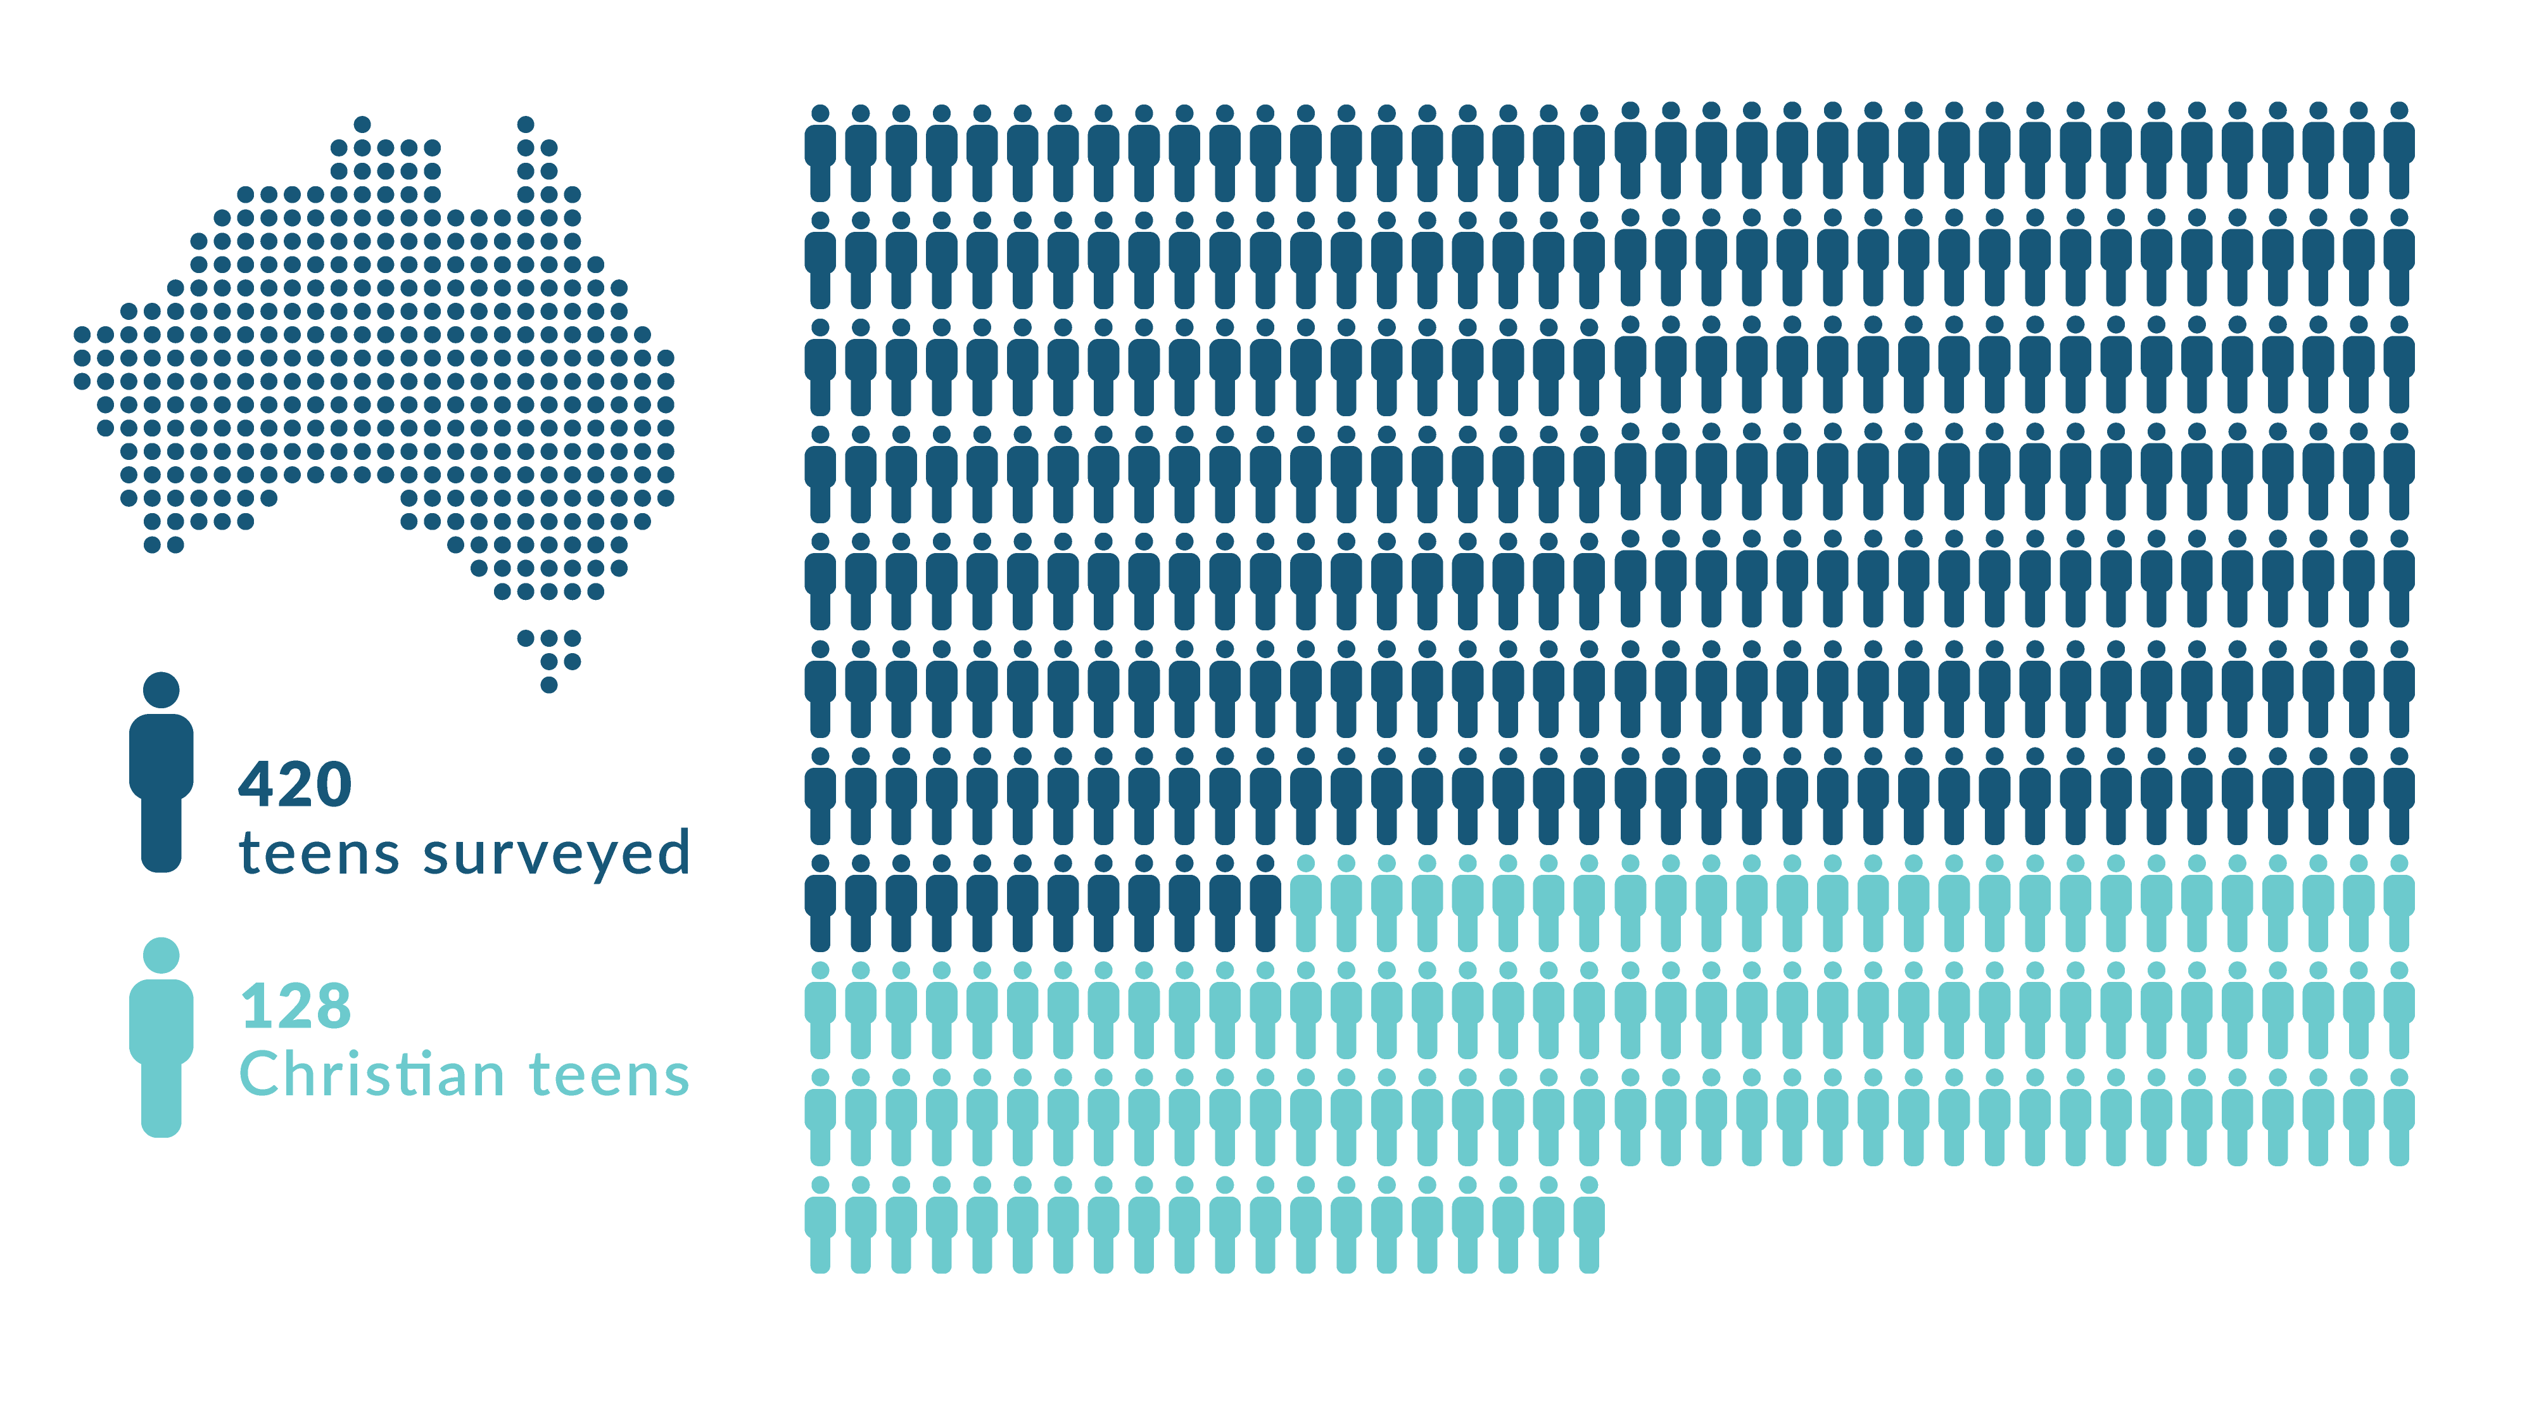
Notes:
Let’s see if we can trace the story a bit of Christian teens and see what is happening to them. I want to hone in on a couple of important stories this data is telling us about children’s ministry. Let’s look at that pool of Christian teens we started with. Of the 420 teens in our sample, we had 128 Christian teens.

Slide 8
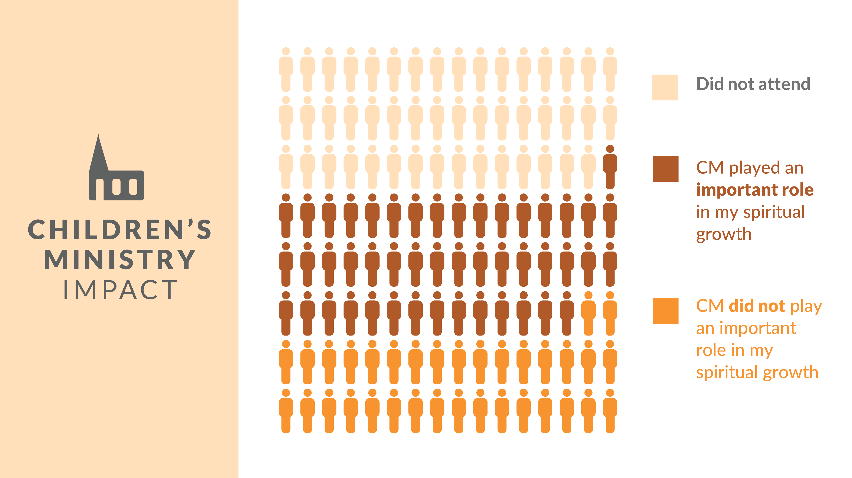
Notes:
Of those 128:
47 did not attend children’s ministry
47 said they did and it played an important role in their spiritual growth
34 said CM did not play an important role in their spiritual growth
So that’s the first thing to know…and I know it’s not news to you. A lot of children simply aren’t at church. You are in an extreme post-Christian culture. That’s out of our control—we can’t force them inside the walls of our ministry.
But, on the flip side—we can do everything we can to steward well the children who do come. We have the best chance of reaching people for Christ when they are young. Children are morally and cognitively developing and are open to the Gospel. We have a responsibility not just to introduce Christ, but to form a child spiritually so they have a faith that is deep enough and strong enough to meet life’s challenges when they come. Because we know those challenges will come!

Slide 9
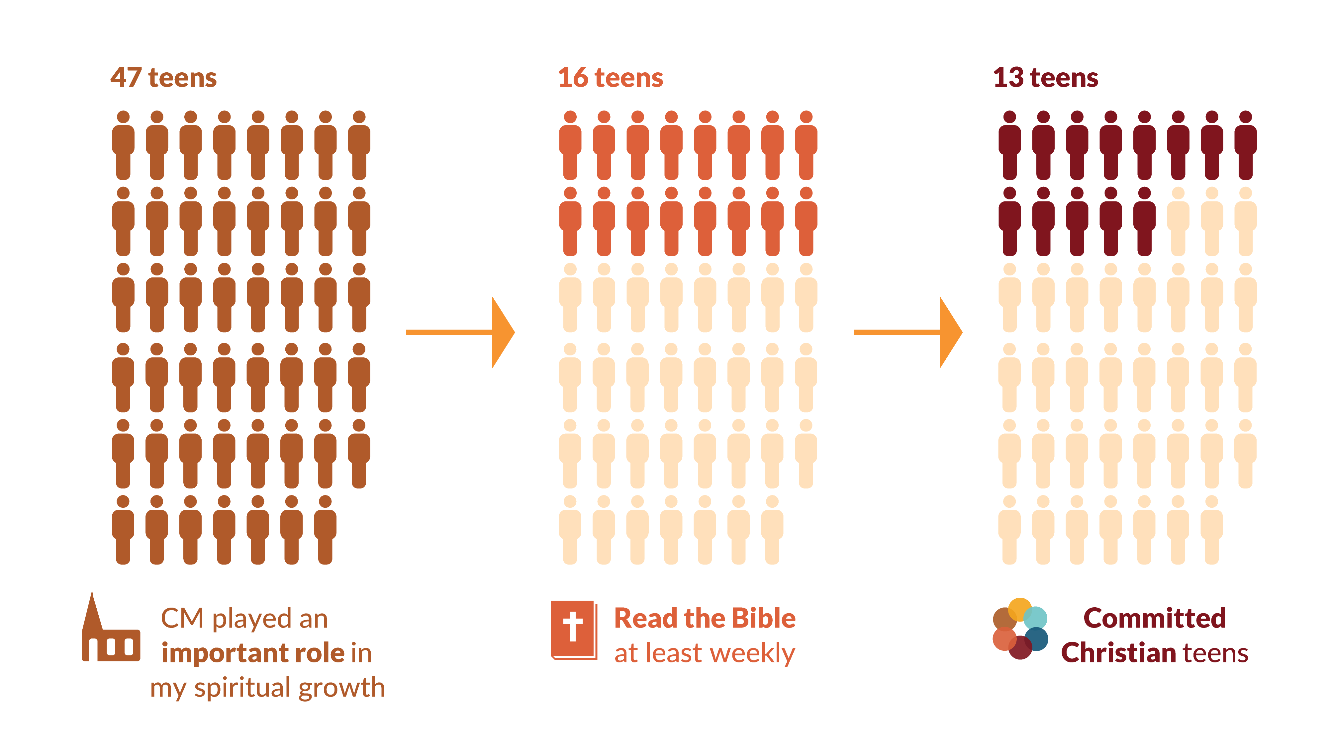
Notes:
Let’s look at the next thing that the data showed, because it is something we can act on. The data is pointing towards a gap in the spiritual formation journey between children’s ministry and youth ministry.
Remember, 47 of our Christian teens said they attended CM and it played an important role in their spiritual growth. But what happened to those 47?
When we narrowed things down, we only found 16 teens who said they read the Bible on their own at least weekly. We know this is an important practice for any Christian.
We further found only 13 who pair that Bible reading with prayer and have basic Christian doctrines. Committed Christians total in our study.

Slide 10
Notes:
To put it another way, 32% of teens in our study identified as Christian. But just 3% have the habits and beliefs of Committed Christians. Let’s look at our definition of Committed Christian.

Slide 11
Notes:
This was our definition of a Committed Christian. The bar was not high to be committed ... 4 basic Christian doctrines and 2 regular spiritual disciplines. These are very traditional and basic beliefs and practices.
A teen who identified as Christian, but didn’t meet this definition of committedness – we called them Nominal Christians in our study.
We had just 13 Committed Christians in the study. I’m not trying to make anyone feel bad, but the data is pointing to a gap. Somewhere along the way, we’re losing our kids. We’re not forming in them basic beliefs and that critical practice of Scripture engagement that is going to grow their faith.

Slide 12
Notes:
It’s not just your country that is experiencing this. We saw this same gap all over the globe in every region we studied. These gaps are huge!
For every 100 teens in Australia, you have 29 who say they are a Christian, but only 3 who are Christian and know what that means. Only 3% are committed to their faith!
Our problem is greater than having more kids claim to be Christian. Our problem runs much deeper.

Slide 13
Notes:
I want to ask us to think about that transition between children’s ministry and youth ministry. Who is picking up the baton for spiritual formation?
A lot of teens themselves are not sure. Of those 47 kids who said children’s ministry was important in their lives:
Only half (25) can confirm that their current church has a pastor or teacher specifically for teens or young adults. 12 said no and 10 said unsure.
If they’re unsure, they’re not connecting. So that’s nearly half who have not made a successful transition into an intentional youth ministry to further their spiritual growth. They’re not even sure who at their church should be leading them in this season of their spiritual journey.

Slide 14
Notes:
Another thing we saw in the data was that this generation is not in God’s Word. The vast majority of teens in Australia say they never read religious Scriptures and that applies to Christians too. Nearly half of Christian teens say they never read the Bible.

Slide 15
Notes:
I want to bring this back to Committeds. Because that would be our goal: to raise children and teens to have a strong and active faith of their own.
We don’t know all the factors that help a child become a Committed teen, but the data is giving us at least an initial picture of what helps:
Committeds are formed in a church’s children’s ministry. Of our 13 Committed teens, all but 2 said they attended and it was important in their lives and spiritual growth.
The majority of Committeds have a youth pastor at their church today (8/13)
Nearly all Committed teens have at least one adult at church who is helping them grow spiritually (not a member of their family). 11/13 have this. We know from other research that spiritual mentors are key to creating a sticky faith in young people.
Another important factor not represented here is the role a child’s family plays in their spiritual formation and growth. We’re going to get to some data later on the powerful role of parents. Because they are the other half of this equation. In terms of time spent with their child—they are way more than half! They are the primary disciple makers. You see kids a few hours a week at most, but families have the majority of the time.

Slide 16
Notes:
I want to leave you with an encouraging statistic to conclude this religious section. Among non-Christians we did see an openness to coming to church. We asked teens if they would be open to attending if invited.
Overall when you look at that yes or maybe category, you have 68% or about 2 in 3 non-Christians said they might be open. Earlier we talked about the fact that a lot of kids are not in our children’s ministries and we can’t force them to show up.
But we can invite them. We think that invitation – and the strength of a personal relationship extending that invitation – are key.

Slide 17
Notes:
The next thing we looked at is the personal experiences and struggles of teens.

Slide 18
Notes:
Here’s a look at what teens told us about their mental health. The data was collected in June-July of 2020, so that was the middle of lockdowns. But we have been seeing a mental health crisis among teens globally. Australia’s numbers are higher, but not that much higher than the global average collected prior to COVID. (Loneliness = 63%, high anxiety = 55%, depression = 45%)

Slide 19
Notes:
Sadly, 1 in 3 teens in Australia reported suicidal ideation (34%). This was higher than our global average (25%). We also learned that girls struggle much more than boys with suicidal thoughts (41% in AU vs 27% of boys).

Slide 20
Notes:
We did dig into this question a lot because it was very concerning to us, and we saw many struggles that connected to suicide risk. These are just the top 5.

Slide 21
Notes:
But here’s a piece of good news: the Bible makes a difference. We saw that Christians did not necessarily struggle less than their non-believing peers. But Christian teens who read their Bible at least weekly did report a difference. These teens were much less likely to be dealing with loneliness, high anxiety, or depression.

Slide 22
Notes:
Another topic we looked at in the research was sexual temptation. Half of Australian teens said they have viewed pornography recently (within the past 90 days) and this grows a lot with age. Unfortunately, Christians are as likely to be struggling with pornography as non-Christians.
Australia’s rates were similar to the global average (48%)
The number of committed Christians is so small in Australia we couldn’t confidently speak to some of these stats for them (13 total out of 420 teens)

Slide 23
Notes:
We also learned that teens are dealing with same-sex attraction. In Australia, 1 in 4 teens (24%) report being sexually attracted to someone of the same gender within the past 90 days. This was higher than the global average (20%) 1 in5.

Slide 24
Notes:
We dug into this a bit more and saw girls were twice as likely as boys to report same-sex attraction. We also saw that Christians are just as likely as non-Christians to be dealing with this and other gender identity issues. Where we did see a difference was among that small number of Committed teens. None of our Committed Christian teens reported struggling in these areas. Being committed to faith doesn’t erase a young person’s struggles, but it was encouraging to see that at least in this area it can make a difference.
You probably have plenty of nominal teens in your ministry – so this is something to keep in mind. They are vulnerable to the world’s sophisticated arguments about gender identity and sexual attractions. You can see how close those numbers are between them and non-Christians.

Slide 25
Notes:
The last topic I want to highlight today is the influences on teens lives. Whose voice do they want to hear? This was important to us and we wanted to find out what they would say.

Slide 26
Notes:
where teens go for guidance about right and wrong and where teens go for questions about the meaning of life. These are foundational conversations. Family wins by a landslide. This was also true globally

Slide 27
Notes:
However when it comes to gender and sexuality family falls to 3rd place with social media at the top. In last place were church leaders We saw similar responses across the globe when it came to this question.

Slide 28
Notes:
You can see how for this generation religion is something much more personal than corporate. Personal experience ranked at the top with a personal investigation as a close second. Also interestingly parents ranked higher than friends. At the bottom was teachings from a religious leader.
This just reminds us how very important it is to help a child cultivate a personal relationship with Jesus to know that the spirit of God is working in them to attune them to God speaking to them. What we teach them as children is only half of what we should be doing. There is a space to be cultivated in experiencing God and who Jesus is at a personal level. Are we making time for prayer, for testimony, for confession, for service? as strong as what they incorporate into their personal life.

Slide 29
Notes:
Encouragingly, teens did tell us they are talking to their parents about the issues that are important to them. 75% of teens said the are having these conversations at least sometimes. Most teens are in two parent homes (67%) and teens overall said their family experiences have been positive (80%).
This is one of the primary opportunities that stood out to us in the research worldwide. This tremendous opportunity the family has to be disciple makers. Parents have more influence than they know. They’re spending more time with their kids than we as church leaders ever will. And teens are telling us they listen to their parents. So how can we equip families to engage well in this space and step into their seat of influence? Parents of young children tend to be the most open to church most open to faith because they do have children. You sit in such a great seat of opportunity. Christianity can grow in Australia through the building of strong faith in children. Parents can be won through their children. It is easy to feel burdened by these stats and we should but if you are like me something rises up in you and says this is important I am filled with the spirit of God and equipped to speak into this generation and I am committed to do it.

Slide 30
Notes:
Does anyone have any questions?

Slide 31
Globalyouthculture.net

